Slide 1
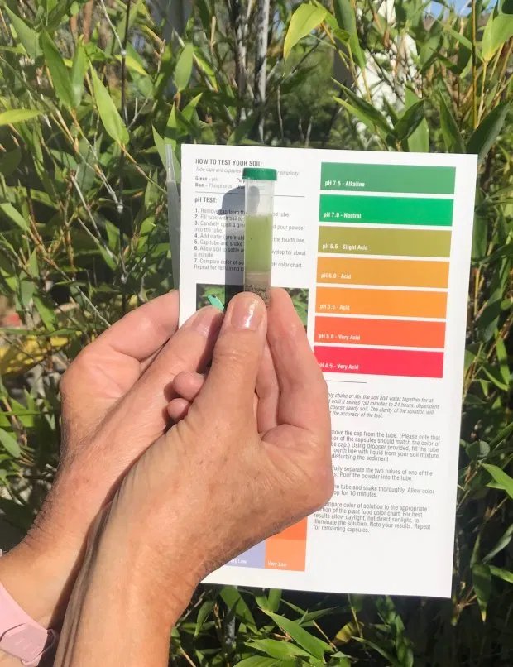

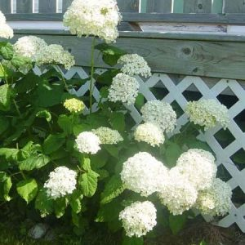
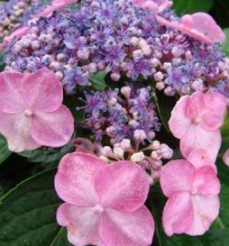

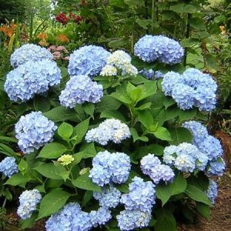

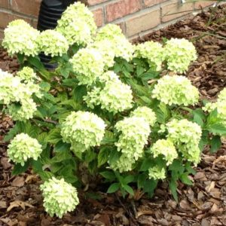
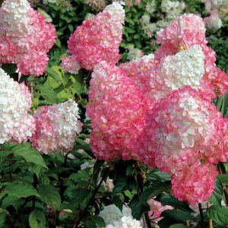

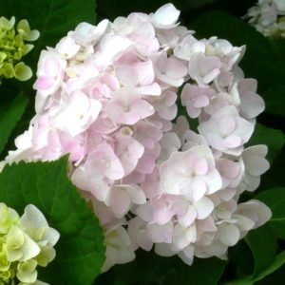
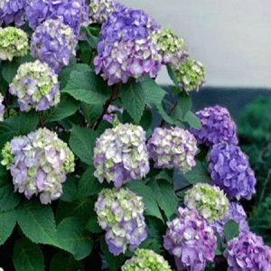

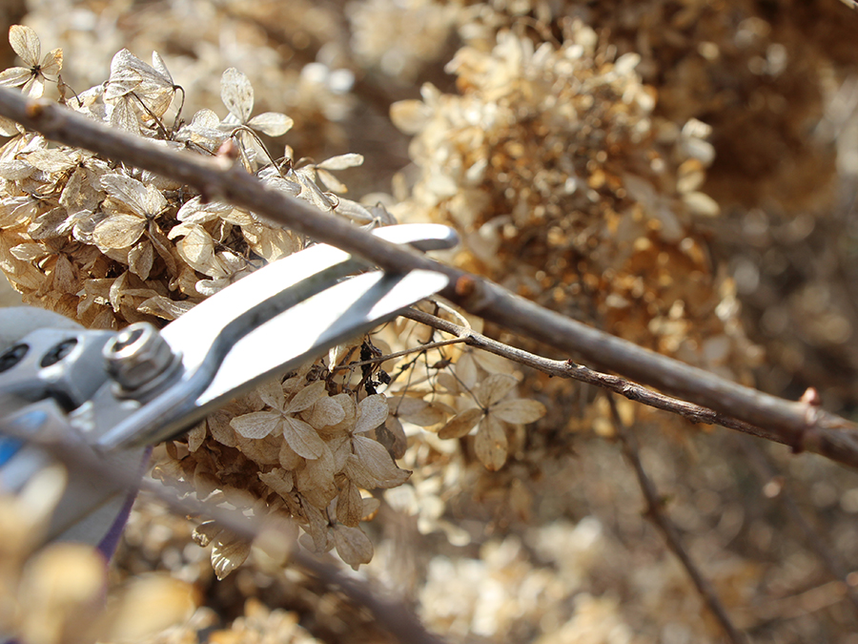
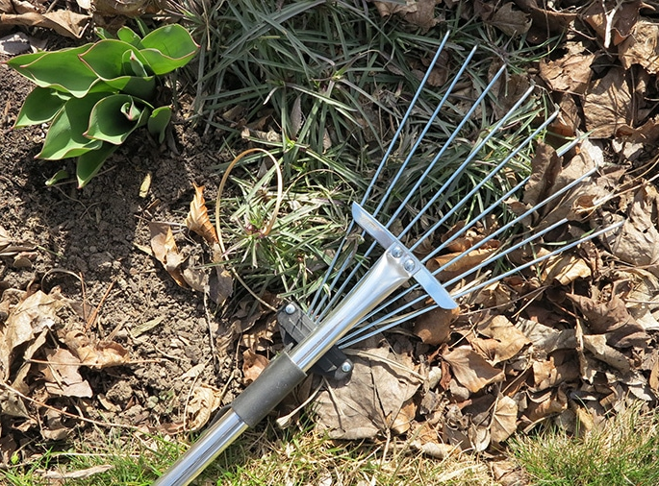
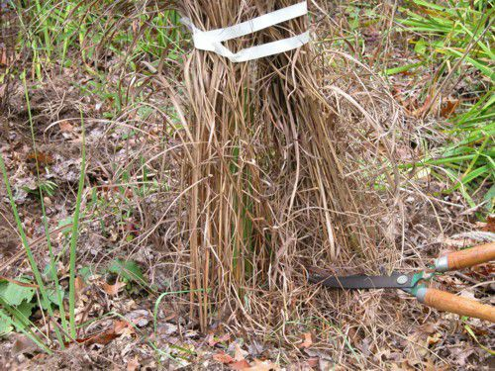

Slide 3

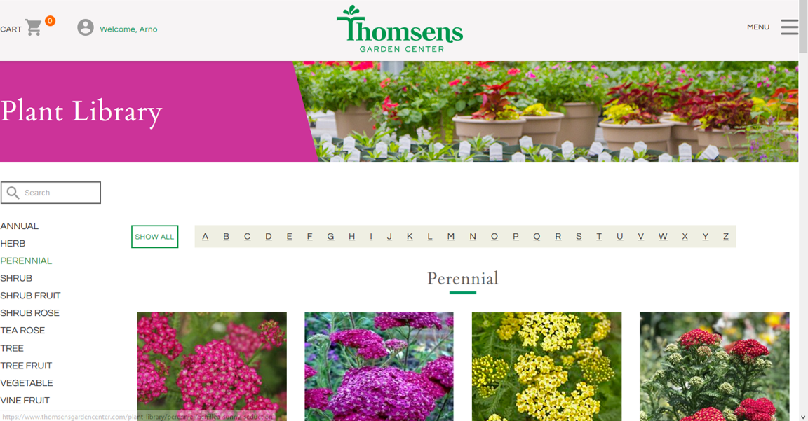

Slide 4




SPRING
CLEANING
YARD
.
.

Slide 5
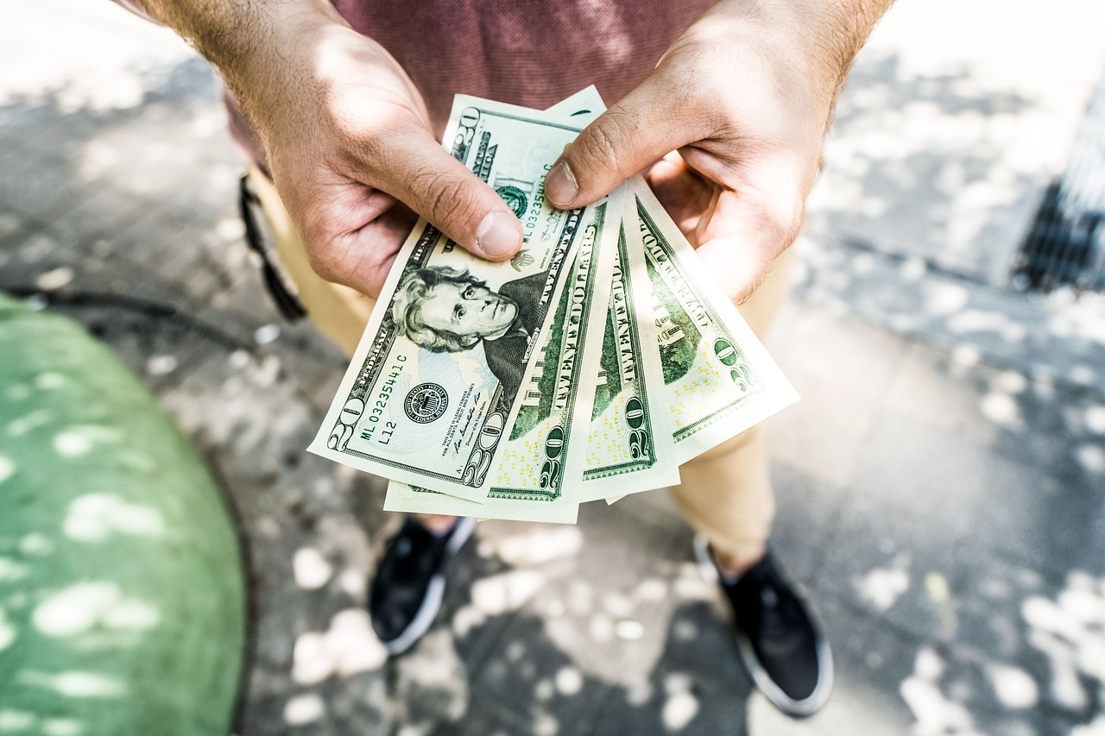
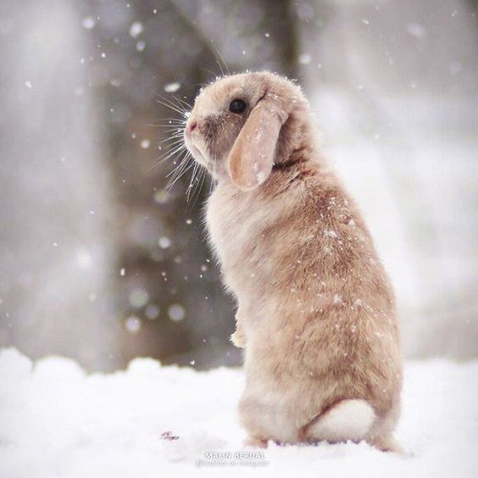




Slide 6

from all of us at Thomsens

Slide 7
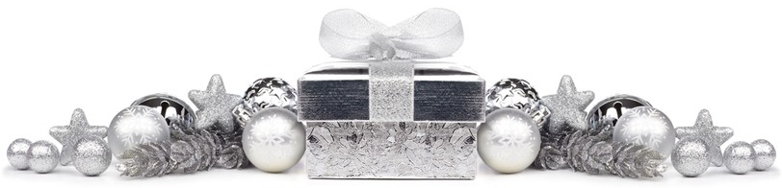


from all of us at Thomsens

Slide 8

Please Join us…
Alzheimer’s
Remember Me
Patio Party
Tuesday, Aug 18th
5 pm - 8 pm

Slide 9


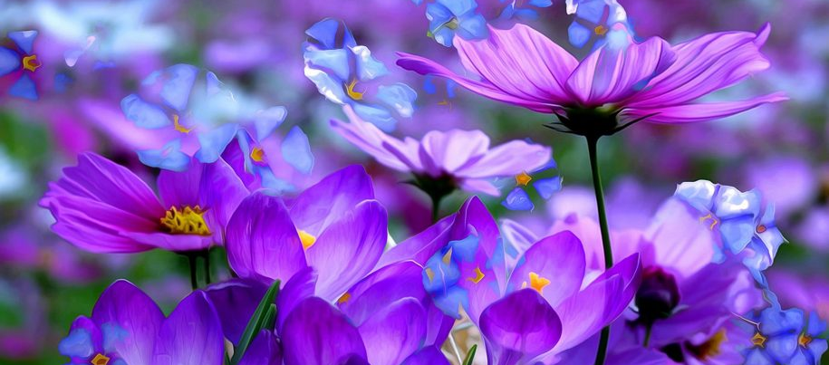
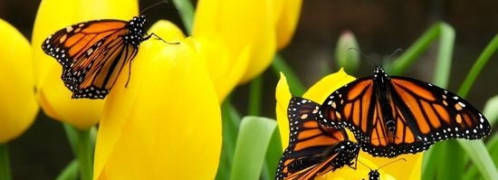

Happy Mother’s Day!
OPENING DAY: April 1st!
It's time to redeem your Instant Green!
OPENING DAY: April 1st!
July is the time to redeem your Instant Green!
OPENING DAY: April 1st!

Slide 10


What a great way to nurture the soul during this difficult time!

Slide 11


Bring this email
to Thomsens
June 23rd - June 30th
for $5 FREE
Instant Green.
Bring this coupon
to Thomsens
June 21-30
for $5 FREE
Instant Green.

Slide 12
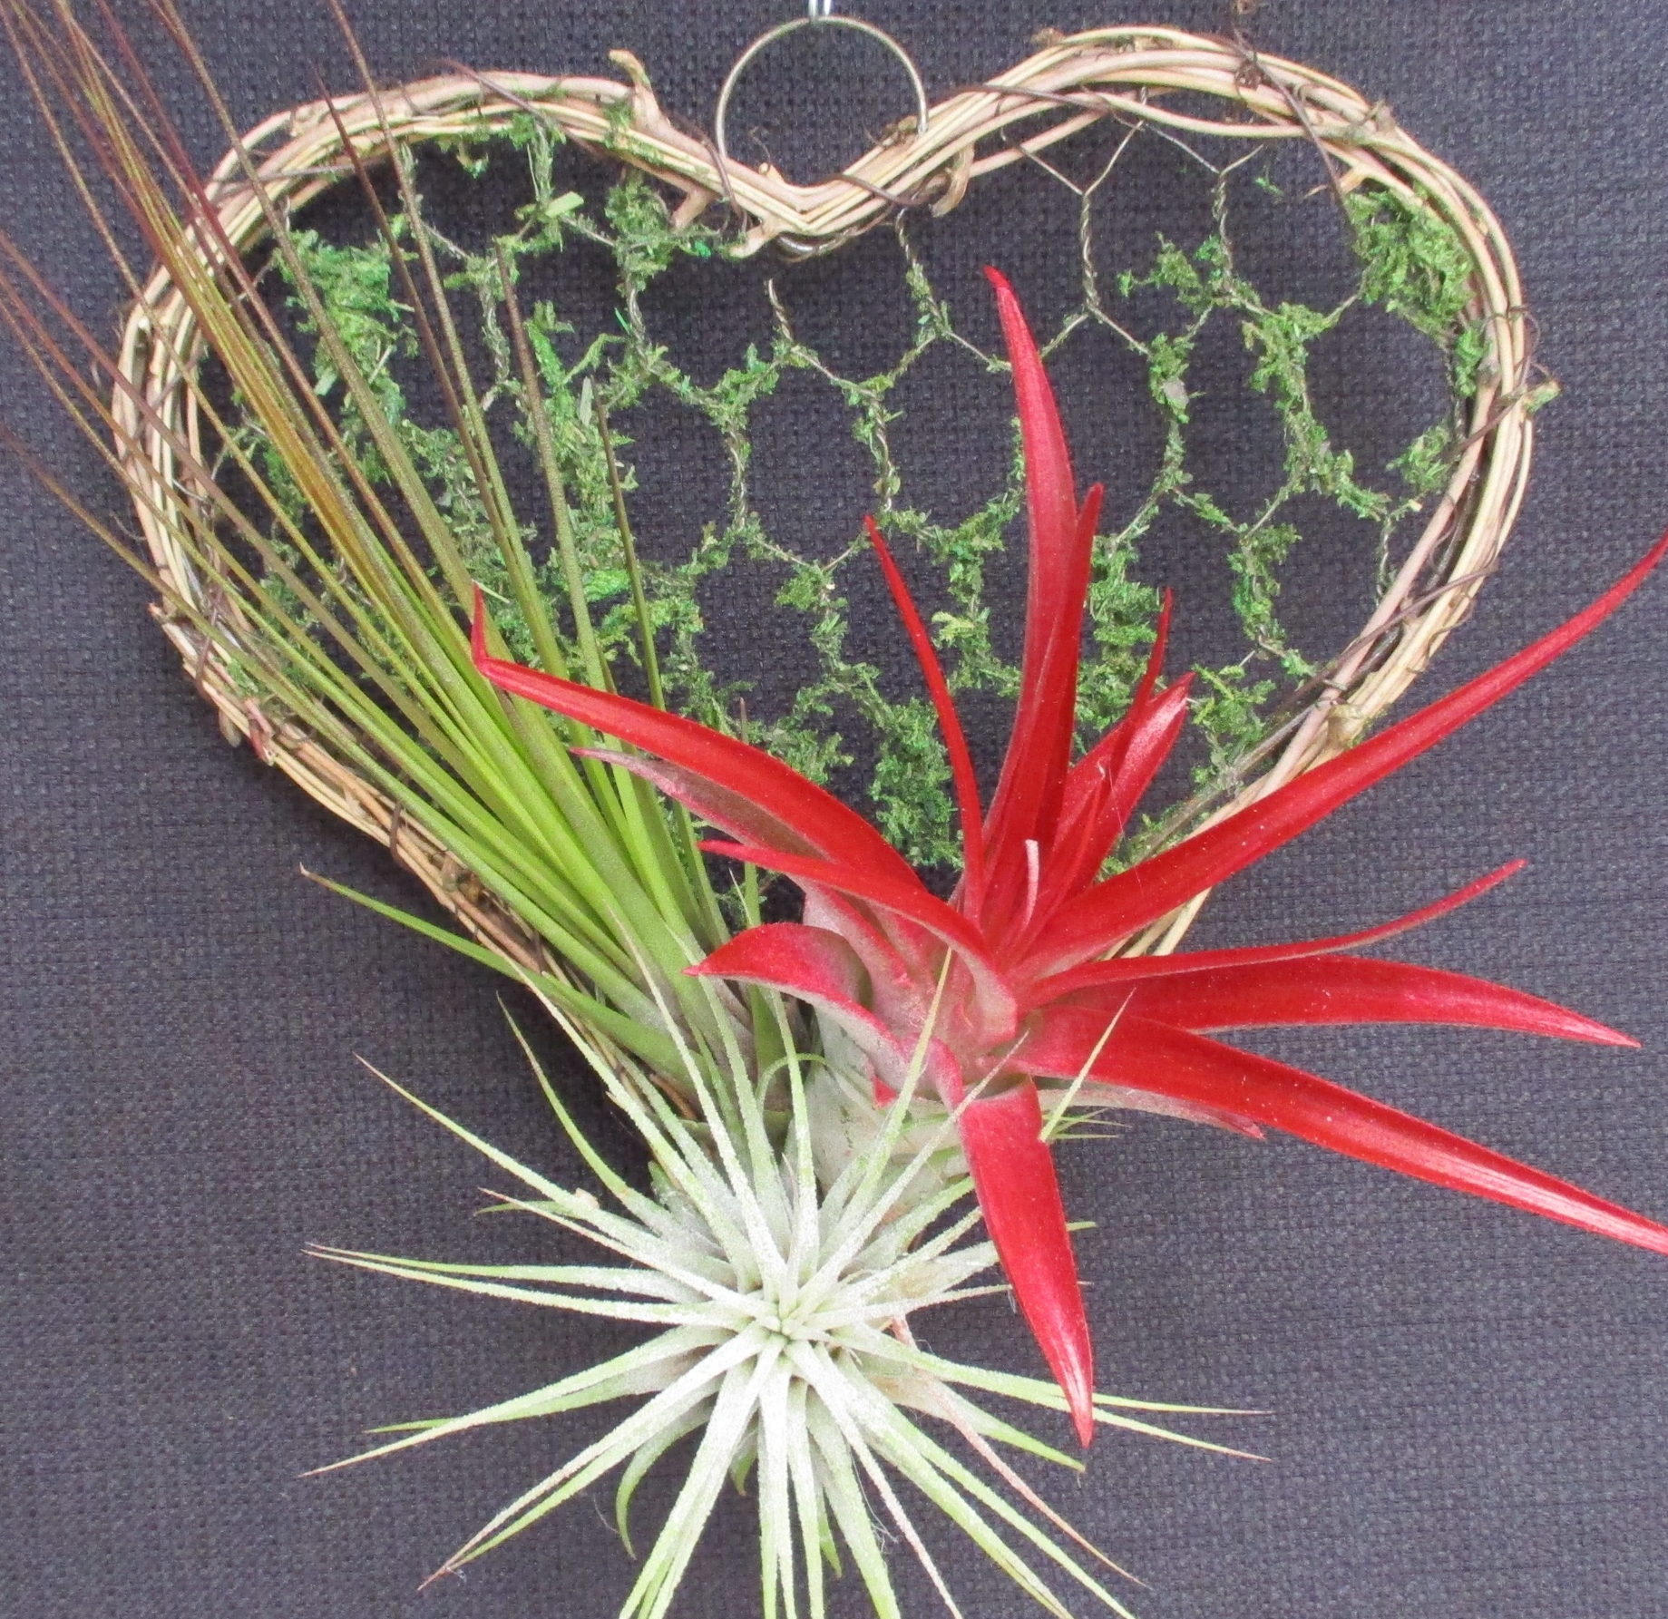


from Thomsen’s
from Thomsen’s

Slide 13
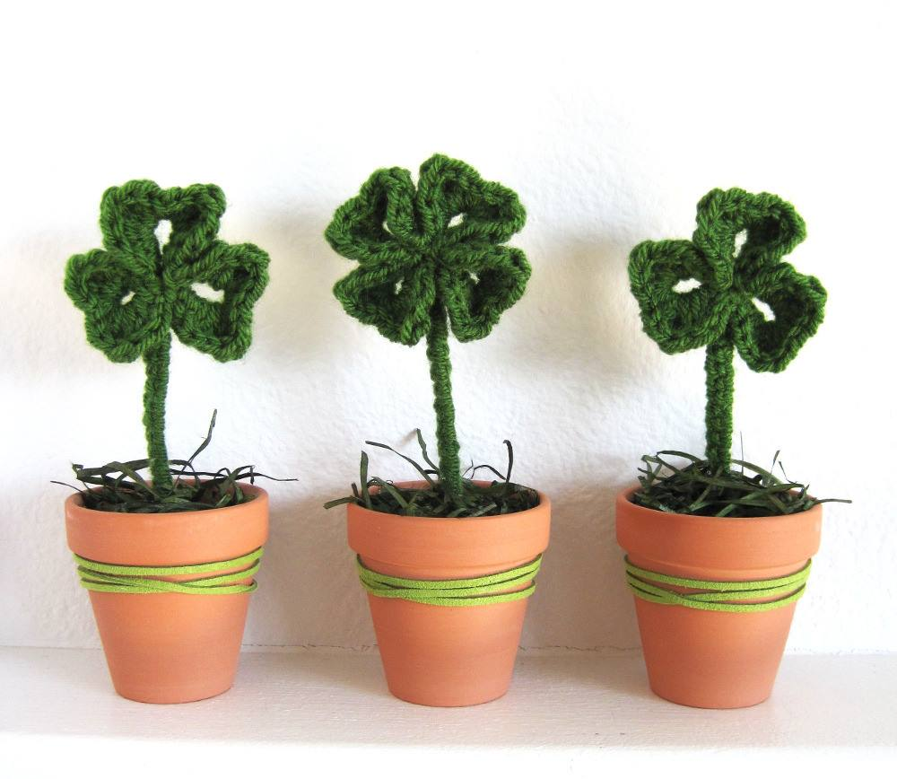

Happy St. Patrick’s Day!
.
.
Happy
St. Patrick’s Day!
from Thomsen’s
from Thomsen’s

Slide 14
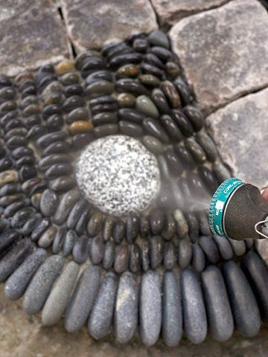
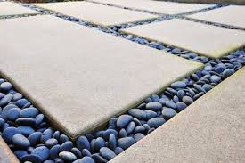
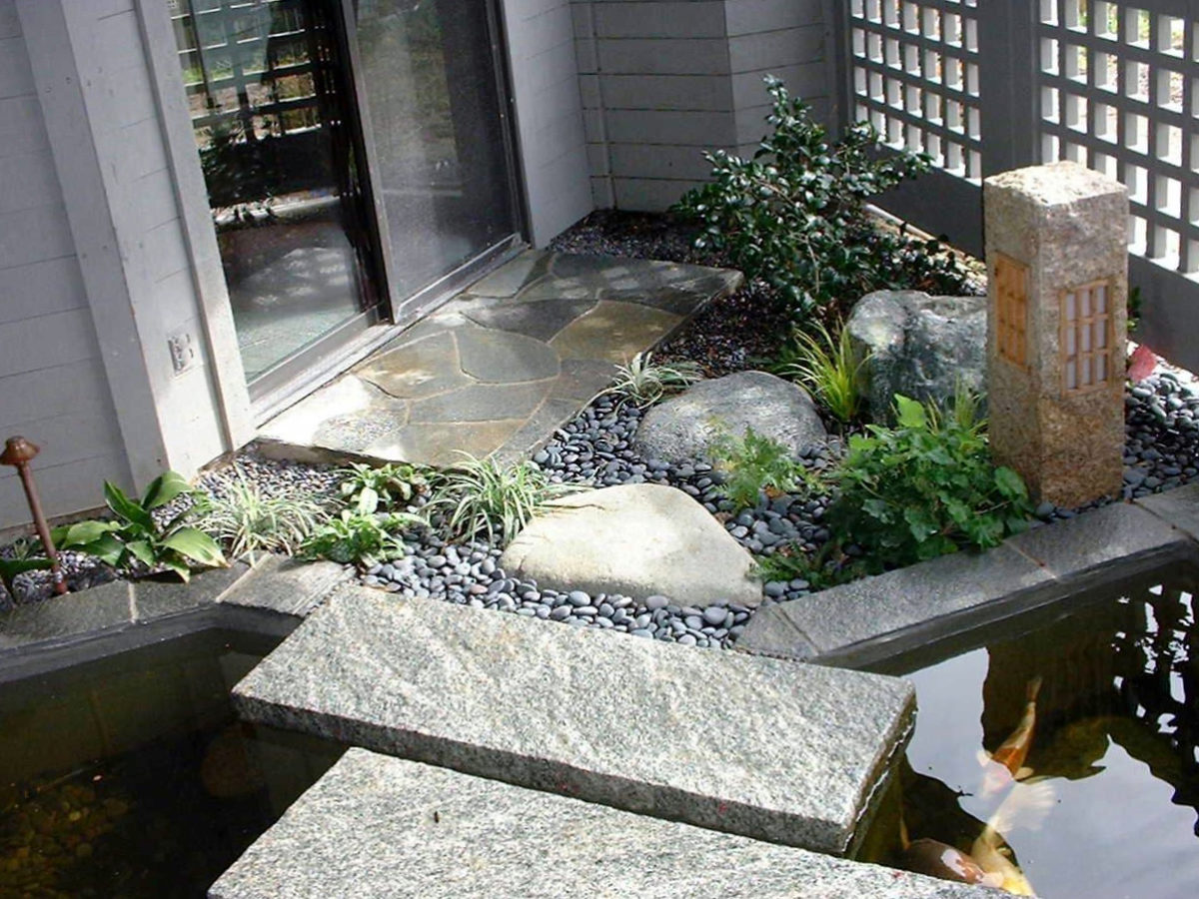
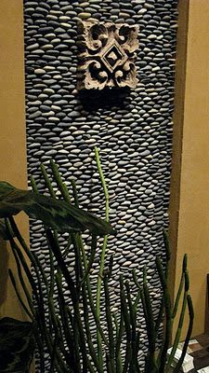
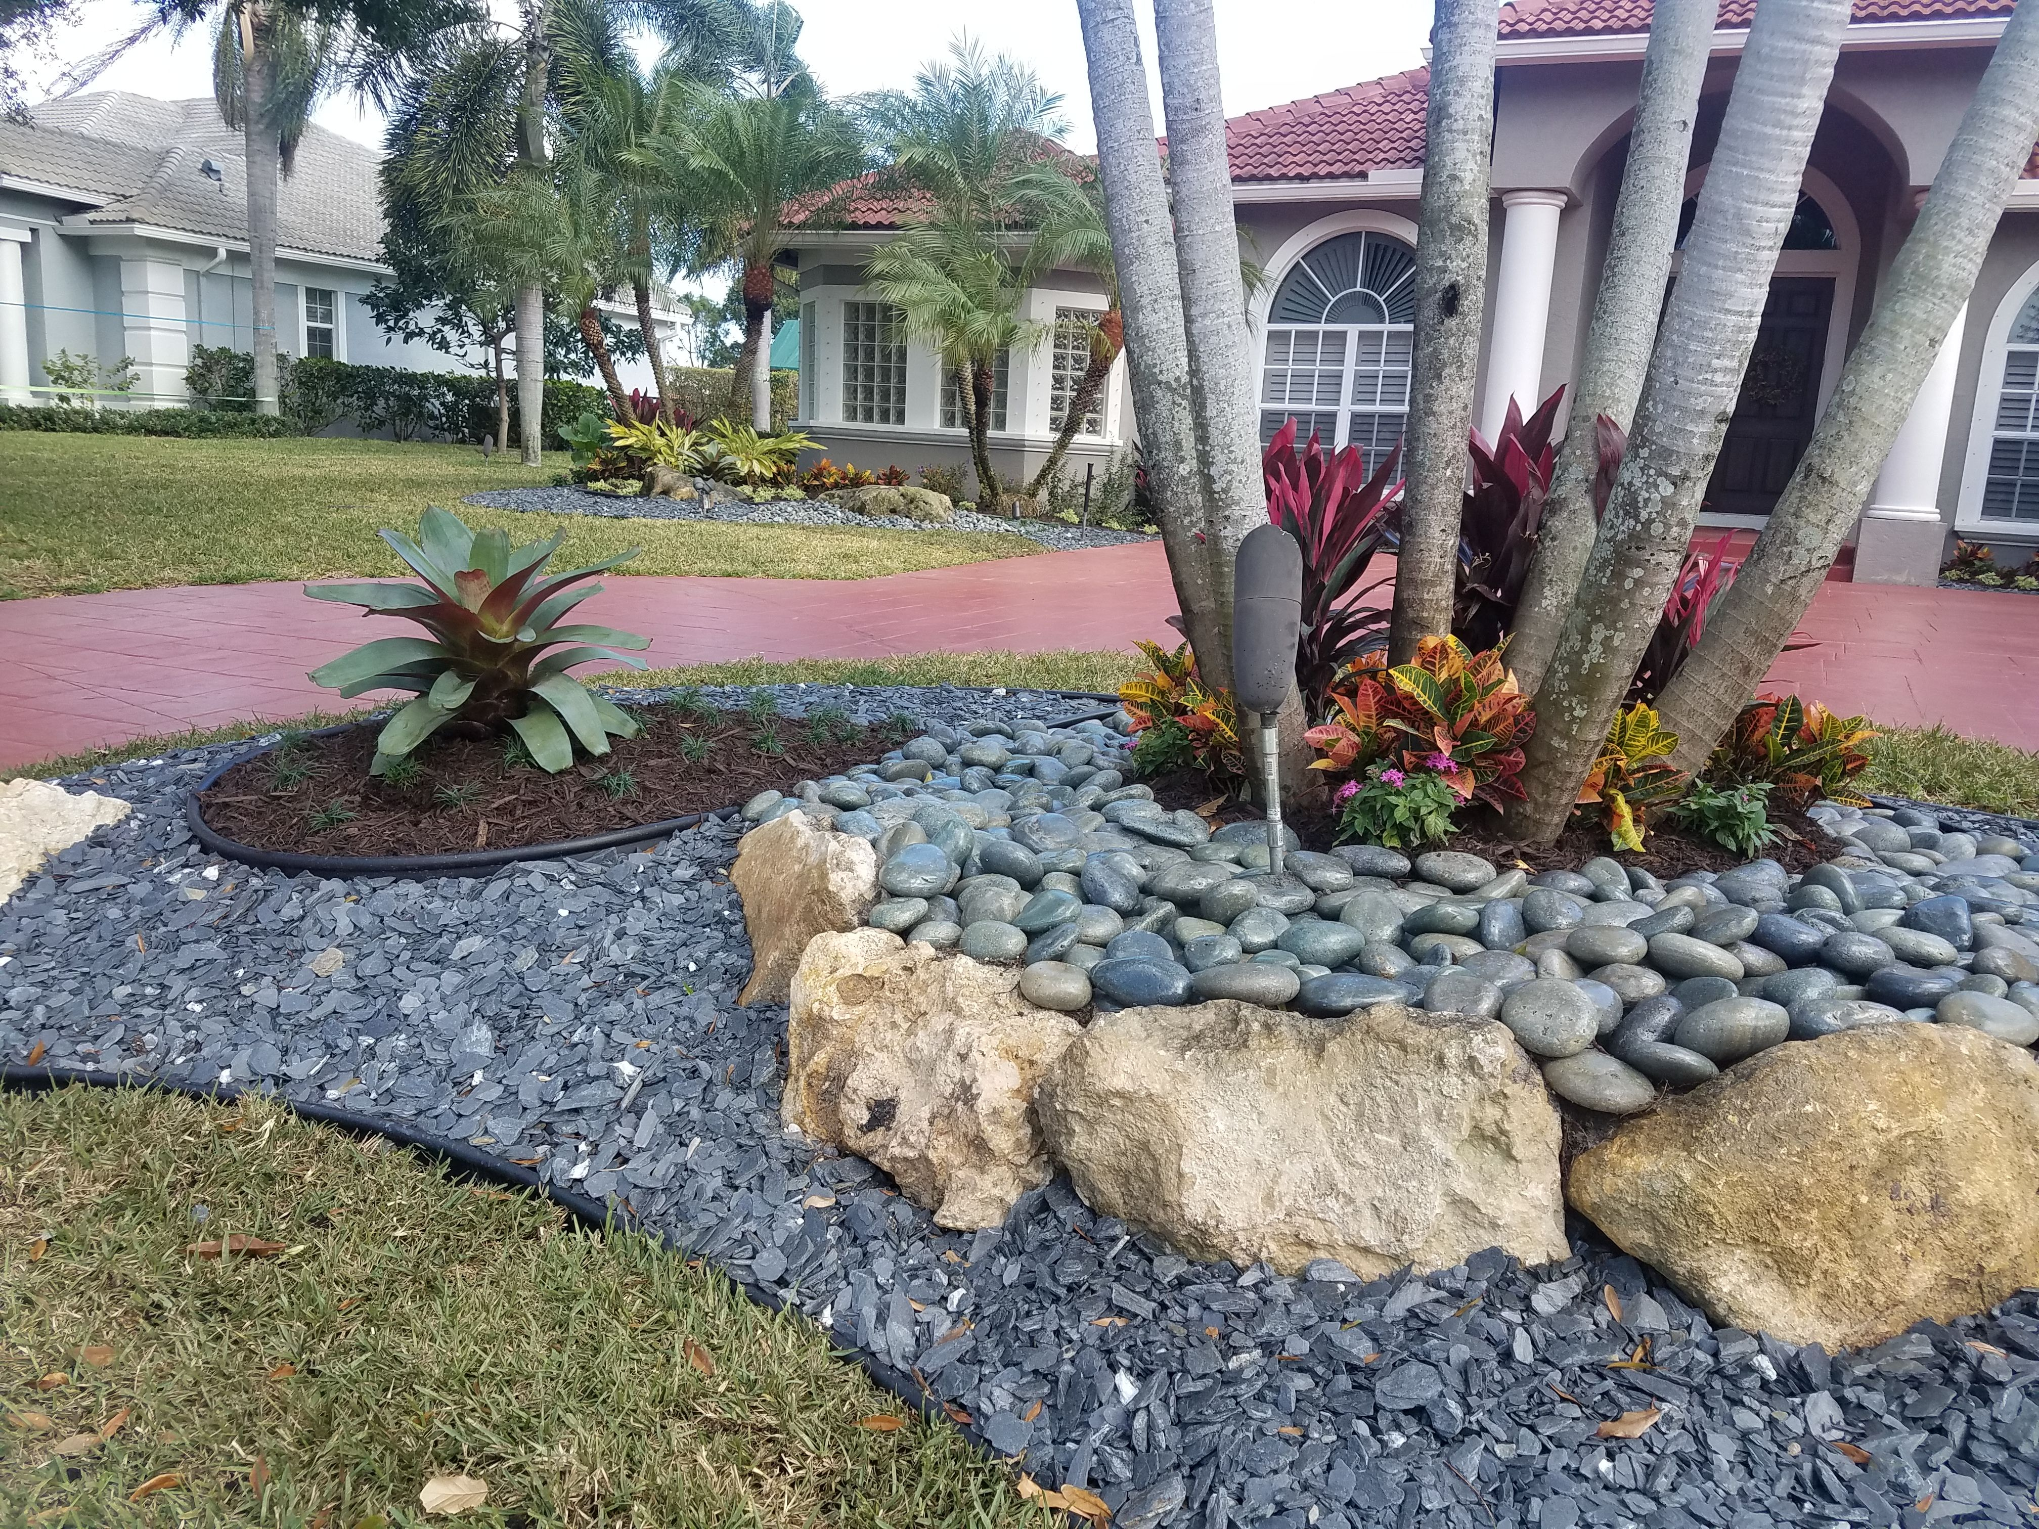
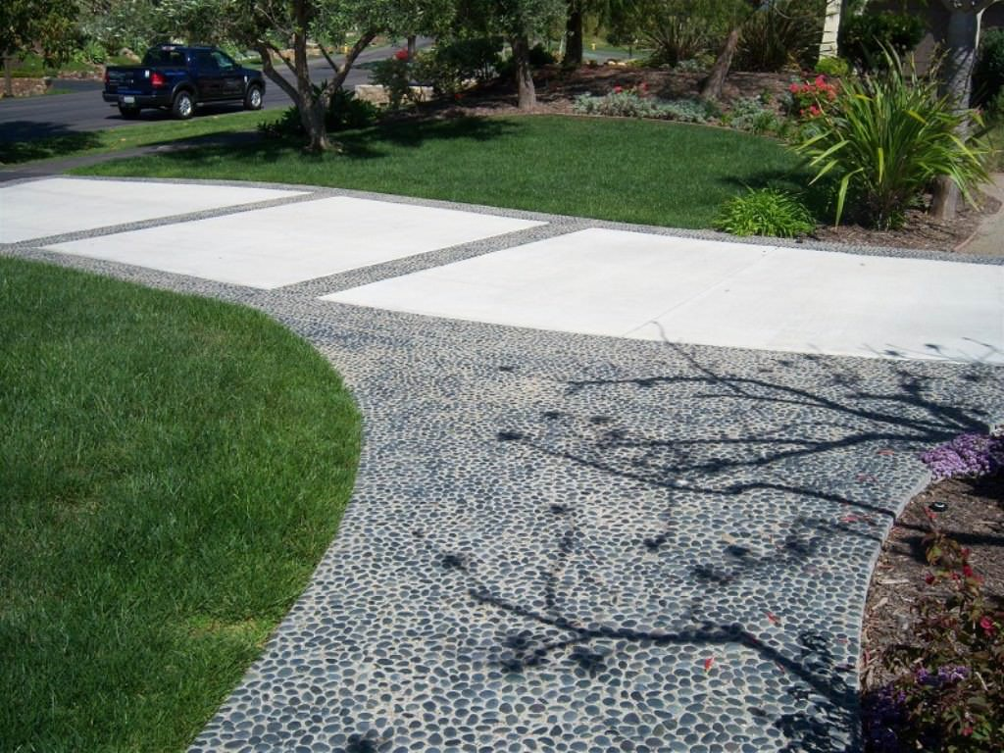
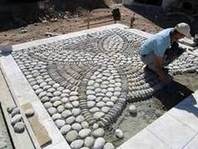
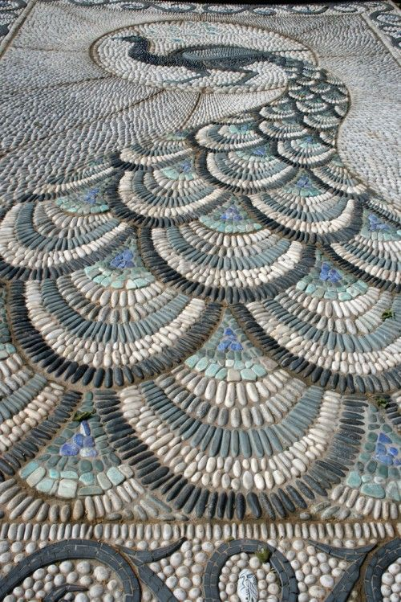
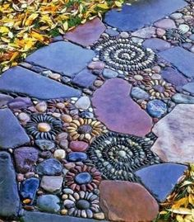
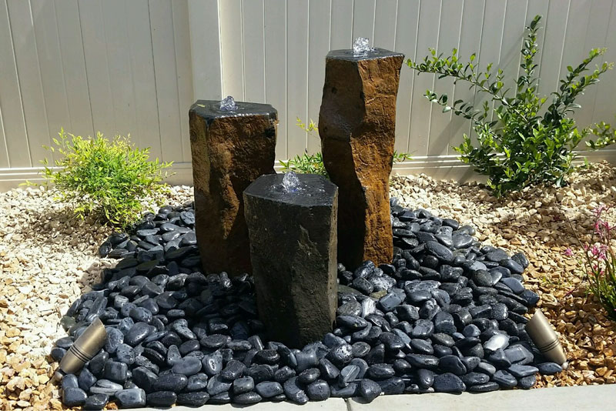
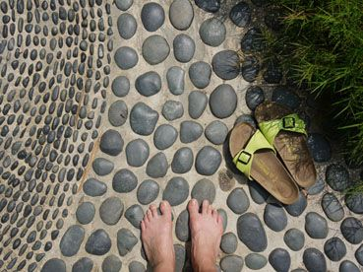

Slide 15


Join us to
Celebrate
MOM

Slide 16



Celebrate
Mom

Slide 17
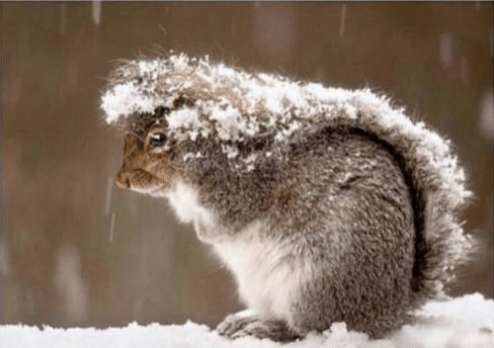
Think
Spring!

Slide 18

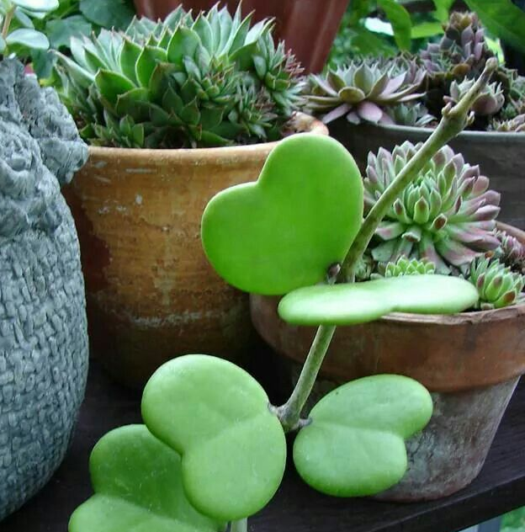

Happy Valentine’s Day!
“Spring is when you feel like whistling even with a shoe
full of slush.” Doug Larson

Slide 19

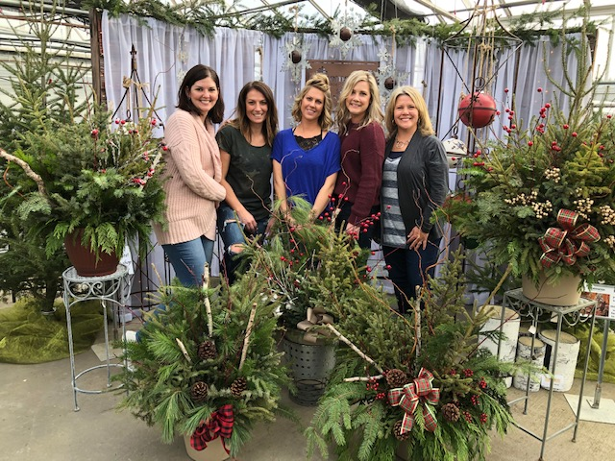
The Holiday Arrangement Workshop ﻿is
Saturday, November 14 & 21
9:30am - 2pm!﻿
Create a wreath, kissing ball, or holiday
spruce top arrangement with help from
our experts.
Enjoy refreshments & spend time with your
friends before the busy holiday season!
Call 320-363-7375 or click below!

Slide 20

Caring for your container once you get it home:
WATERING: It is very important to not over water in cool, wet weather. In hot, windy weather, you may have to water once a day.
FERTILIZING: we recommend fertilizing at least once a month with a water-soluble plant fertilizer to maintain great looking foliage and continued blooms.
DEADHEADING: Most plants benefit from removing the spent blossoms. It is also good to trim your plants to keep them thick and full in your baskets.

Slide 21
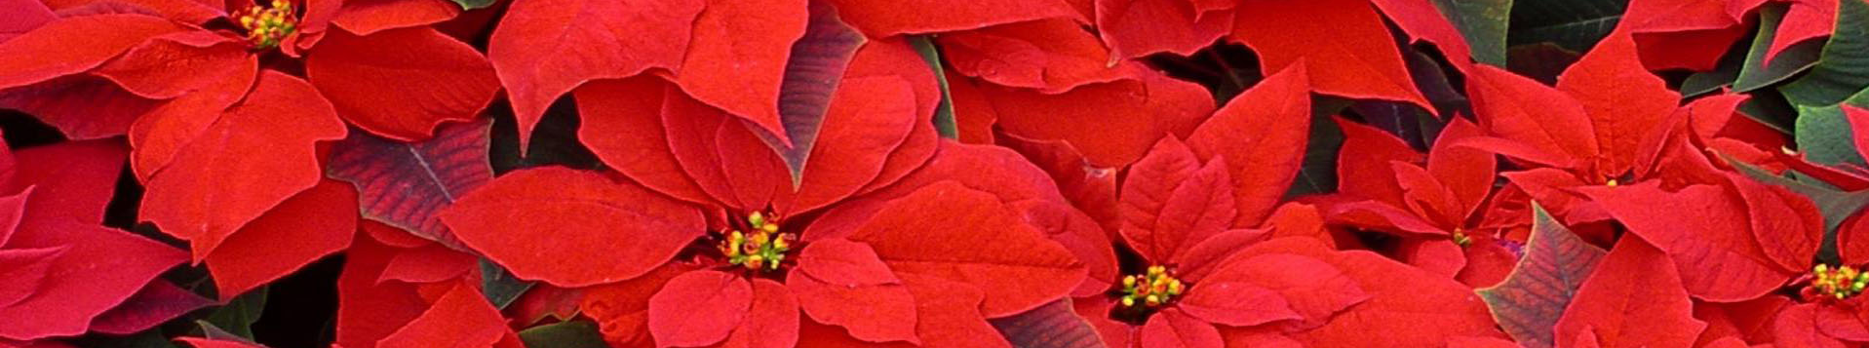
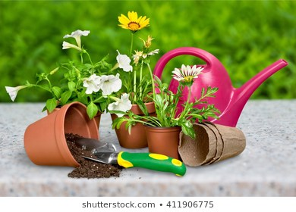

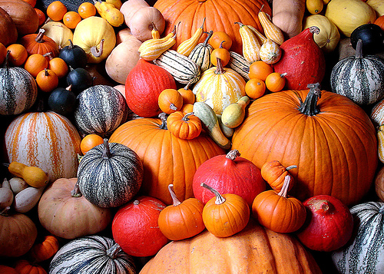

Coming Soon…
Coming Soon…

Slide 22
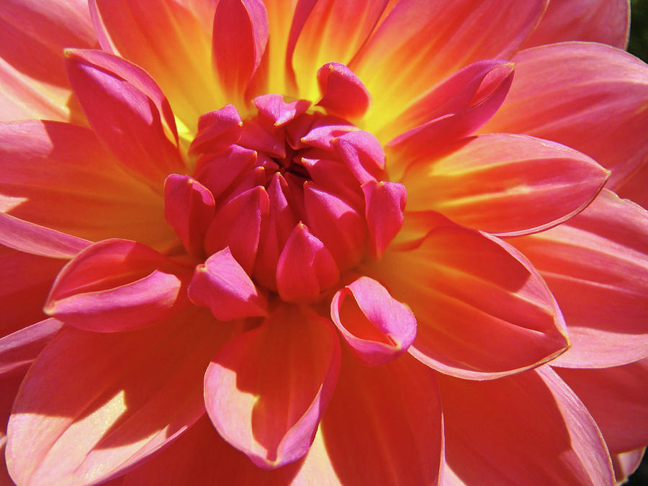
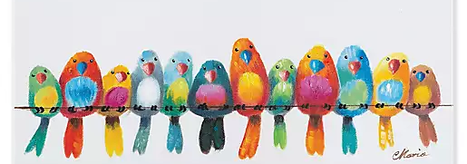


Thank You!
Thank You!
Coming Soon…
Coming Soon…

Slide 23

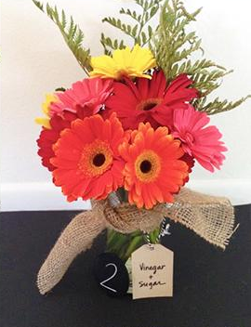
from all of us at Thomsens

Slide 24

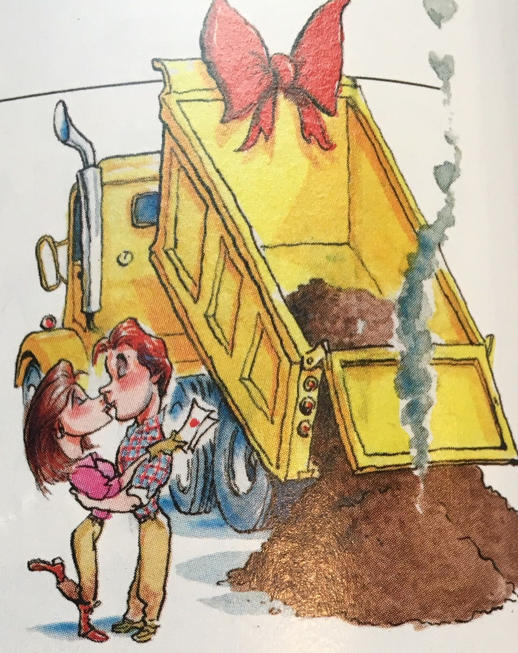


Forecasting the day of the last spring frost is easy. It always comes right after you set out your plants.

Slide 25
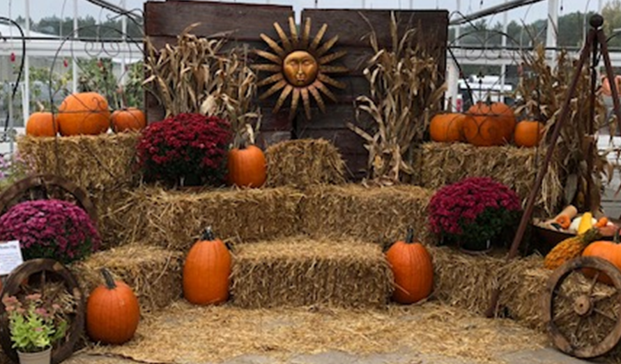
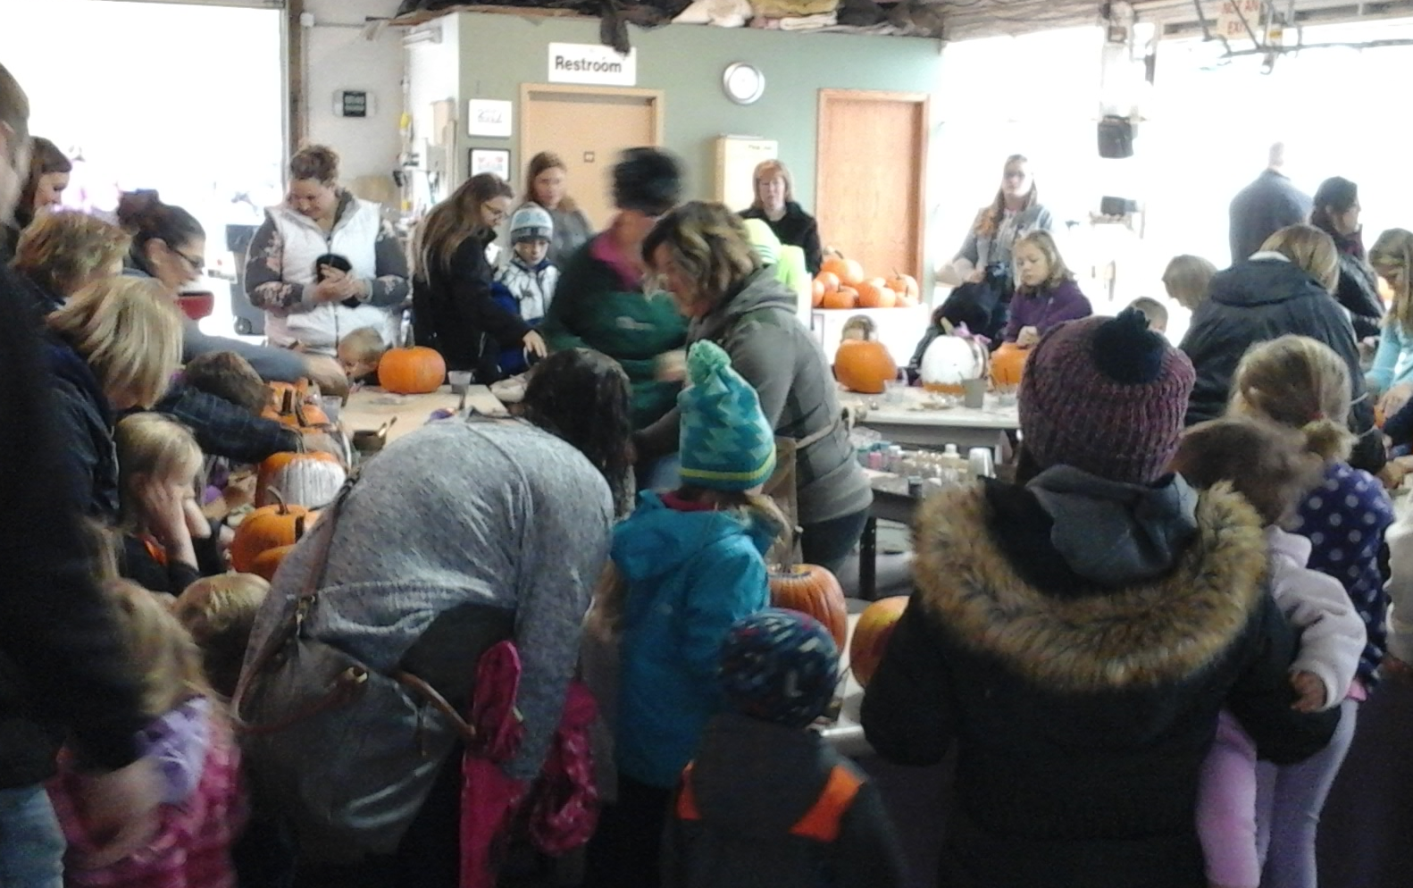
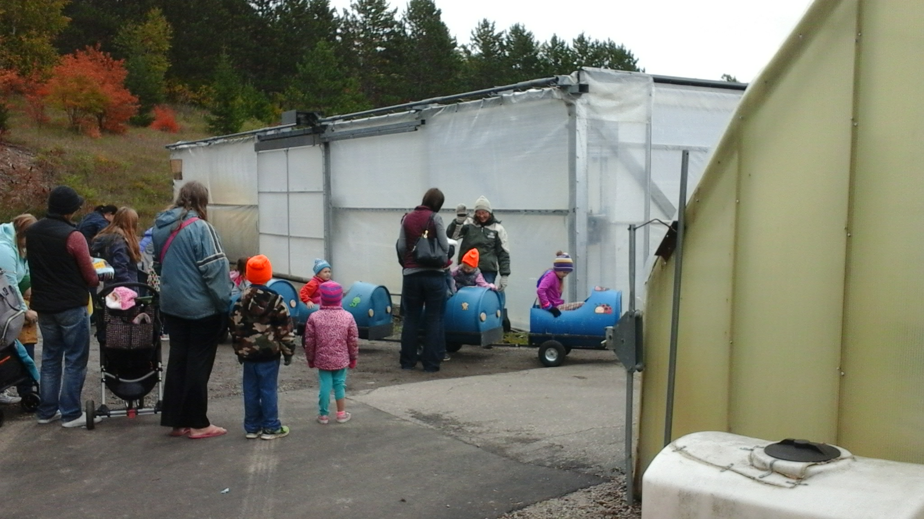
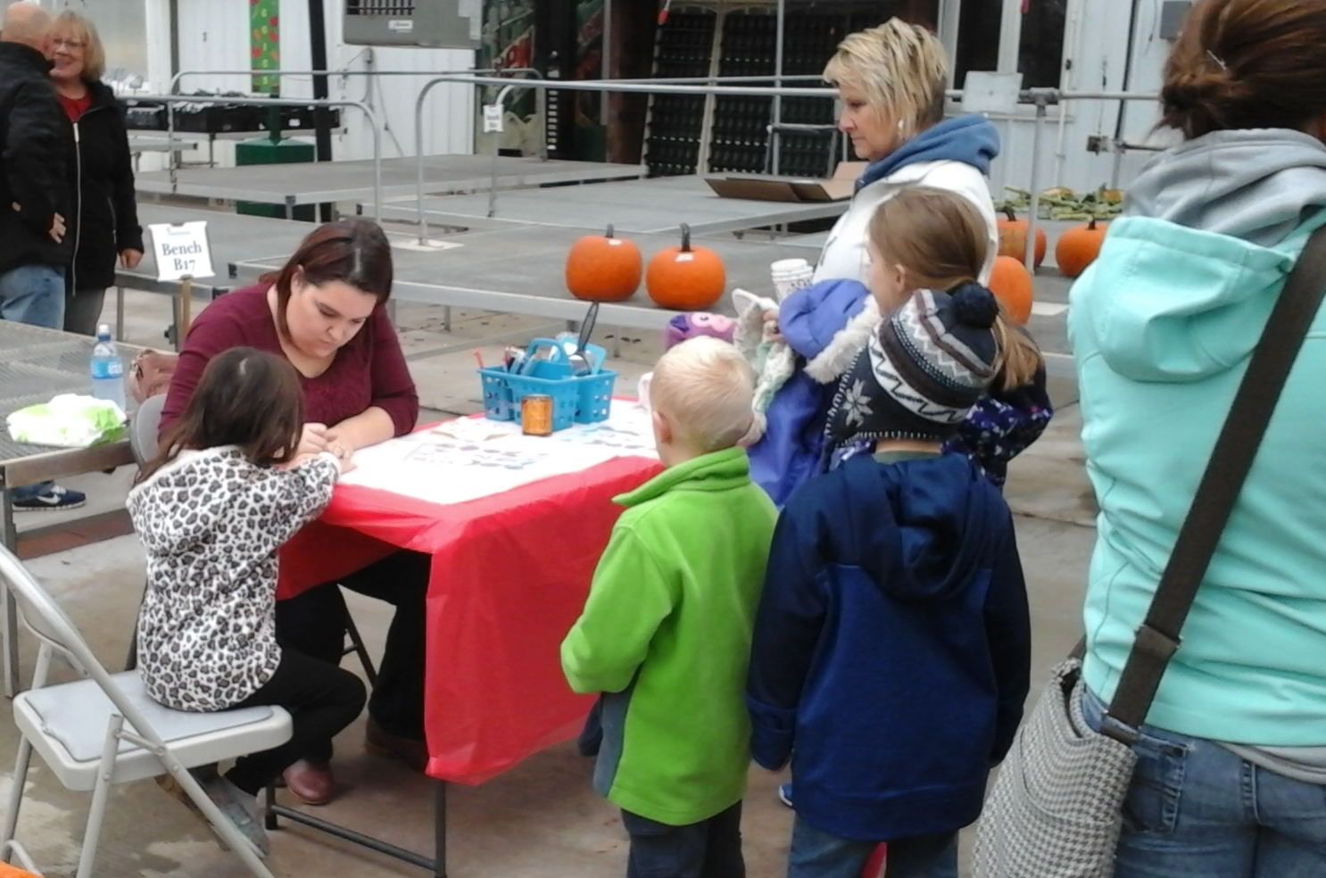
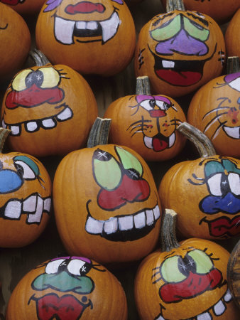
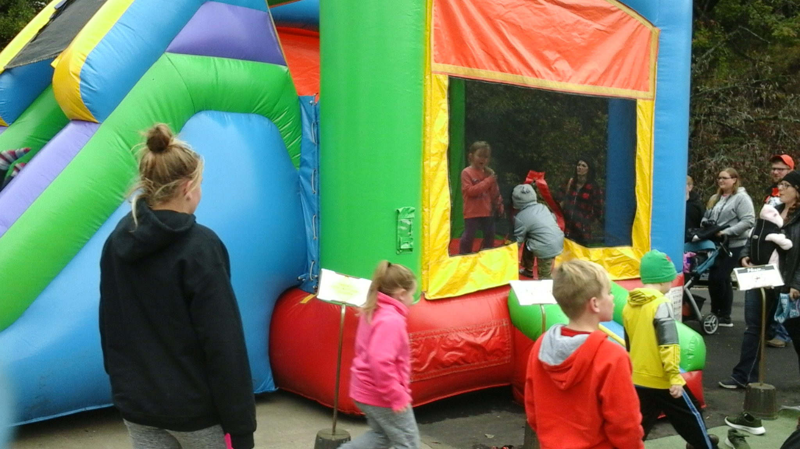

Slide 26
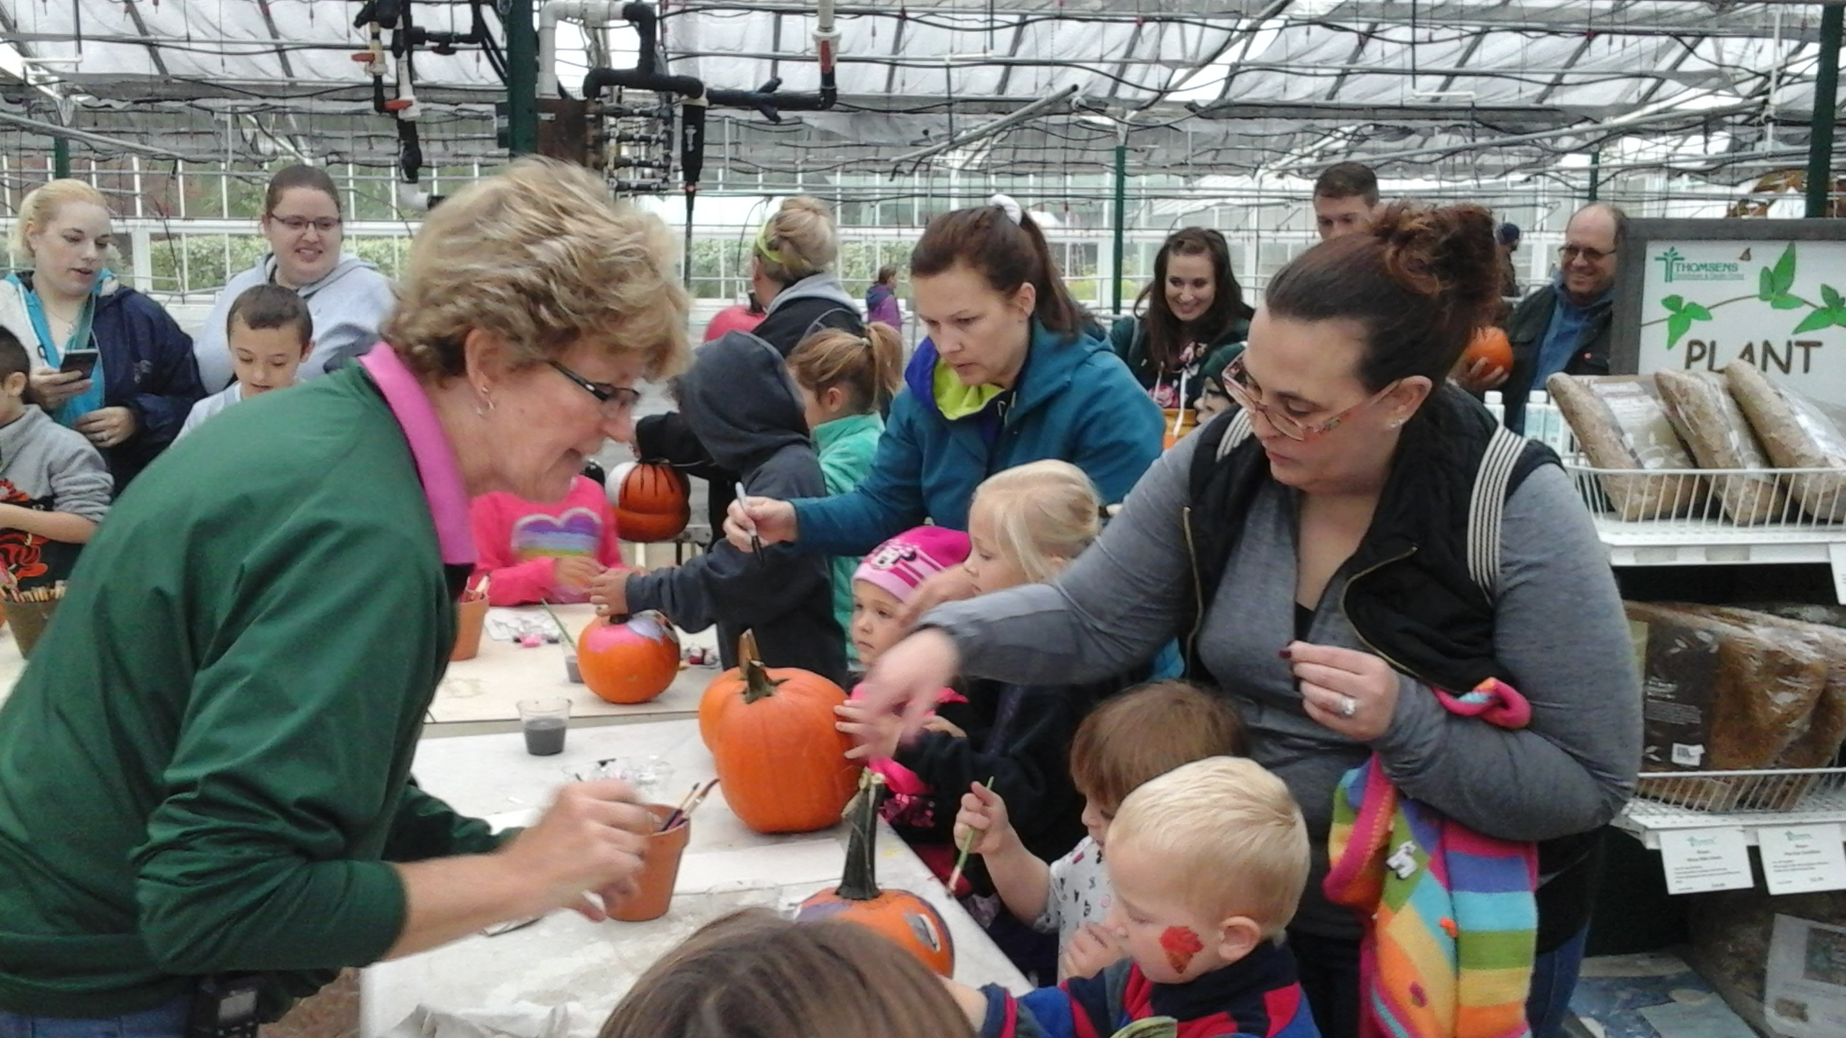
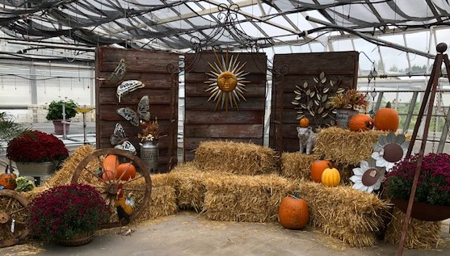
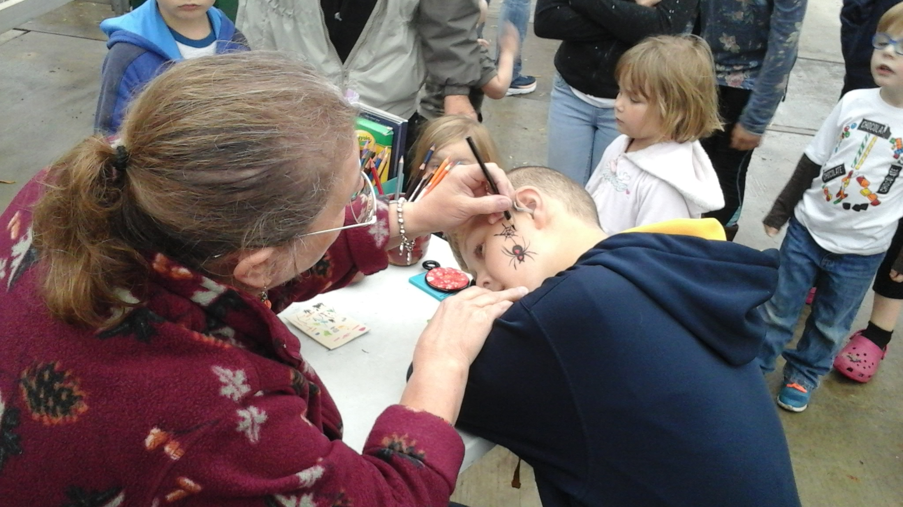
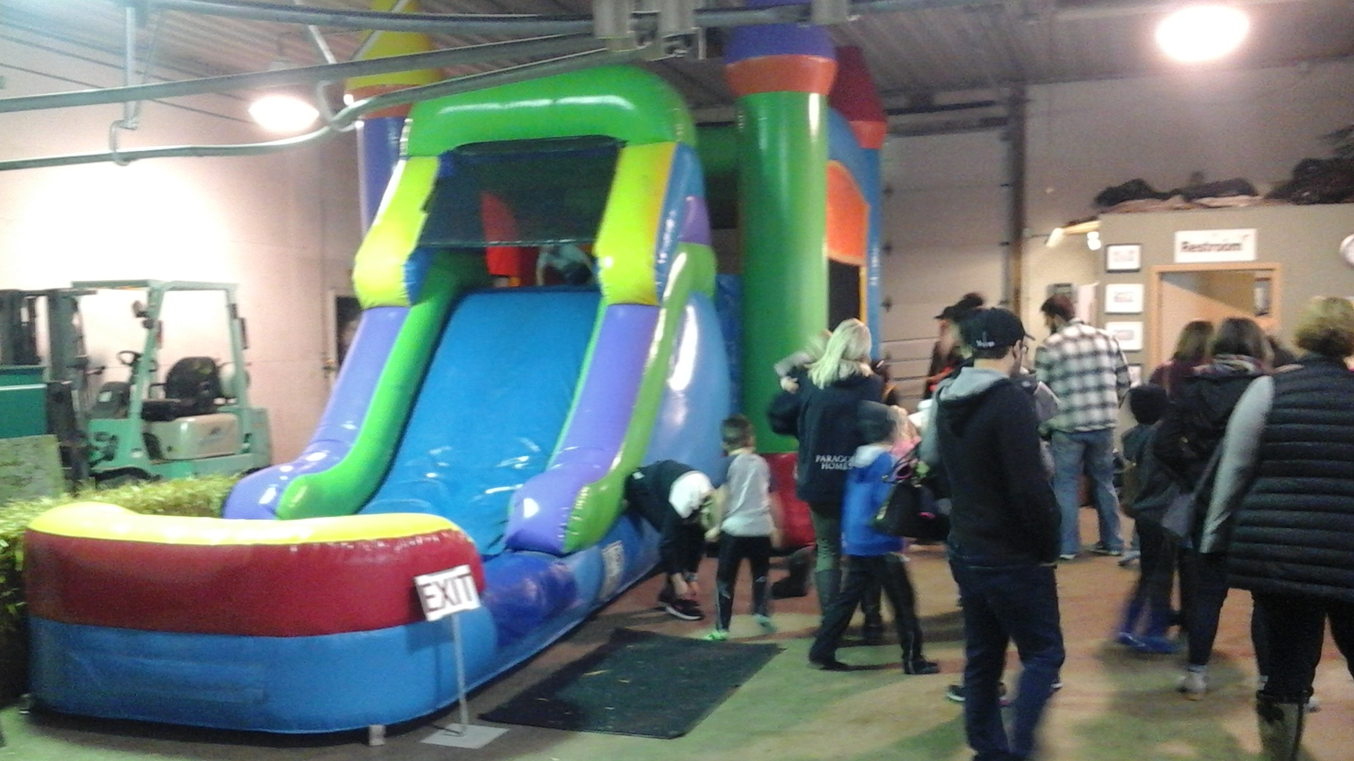


Slide 28


Slide 29




Thank
You!
Spring is Coming…
Thank
You!

Slide 30



Coming Soon…

Slide 31




Plan Ahead for the Holidays…

Slide 32

Need an idea for your
Holiday Office Event?
Or want to schedule a
private party of 10 or more?
Come to Thomsen's to have your team members create holiday arrangements.
Call us today at
(320) 363-7375
to book your date!

Slide 33


Slide 34


Slide 35


